Slide 1
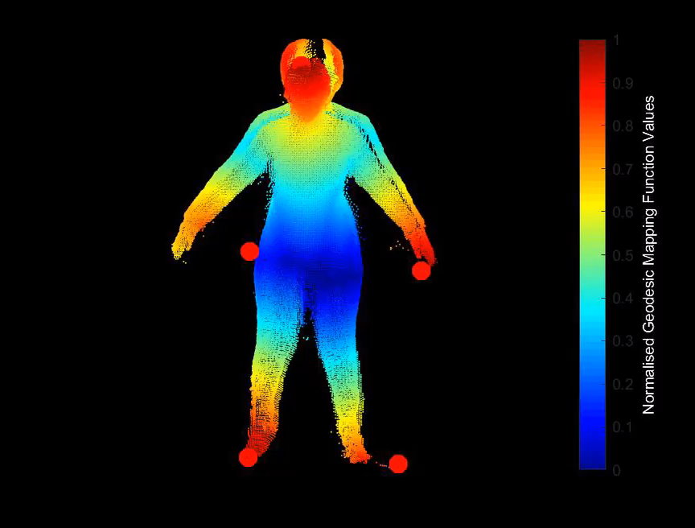
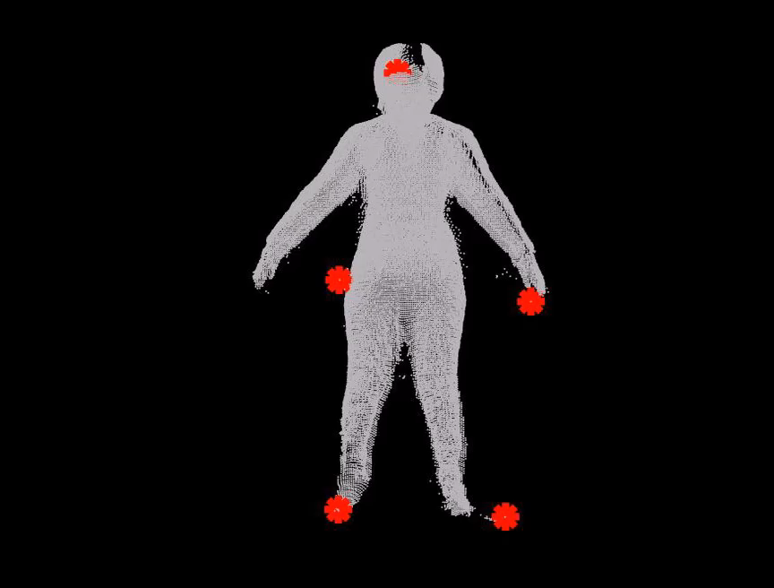

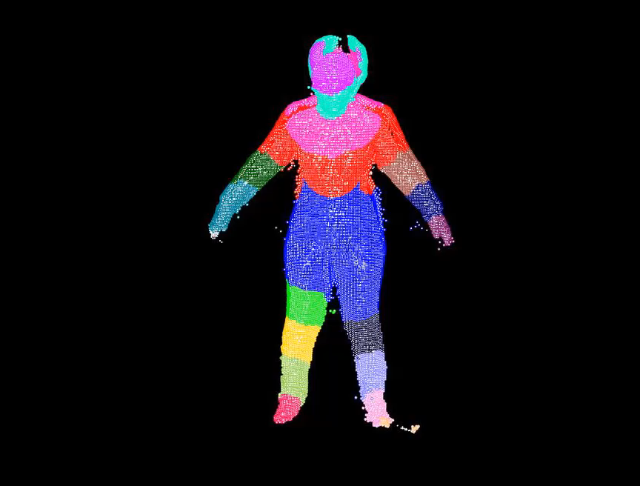
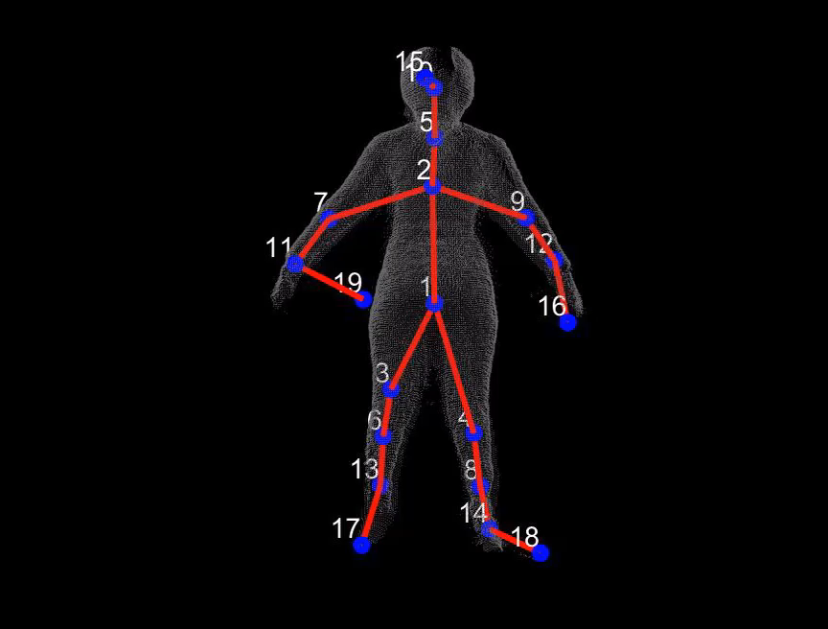
Clustering and Identification of Body Extremities for Pose Recognition Through a Network of Calibrated Depth Sensors
Notes:
Good Morning everyone! I thank you all for attending my thesis defense. For the next 25 minutes, I will be talking about my work. Here is the outline of my talk

Slide 2
Outline
Introduction
Literature Review
System Overview
Experimental Setup
Calibration of Multiple Depth Sensors using Spheres with Retro-Reflective Patterns
Semantic Segmentation of Key Body Extremities through Topological Analysis of Fused 3D data
Body Pose Recognition
Conclusion and Future Works
Notes:
In intro, I will first talk HPR, its challenges and how these challenges can be addressed. Next, I will go over the background on the ways ppl tried to solve in the past and current methods.
I will then gives an overview of the proposed framework
I will describe about Experimental setup which is used to validate the performance of proposed framework
I will then talk about two stages of the proposed framework for HPR
Finally, I ll conclude this talk with discussion on future scope of this work

Slide 3
Introduction
SFU

Slide 4
Challenges in Human Pose Recognition
Human body is highly deformable.
Usage of single cameras susceptible to ambiguities such as self-occlusions and limited FoV
Illumination variations lead to compromise in RGB data
Notes:
However, certain challenges are found while developing HPR system
Most works have successfully performed HPR with single sensros. However….
These systems also require the subject to face the camera and perform in restricted manner …whose feature extraction can be further complicated by self-occlusion and illumination variations
These challenges are addressed by using multiple depth sensors

Slide 5
Advantages of Multiple Depth Sensors
Multiple sensors -> more visible information on subjects and less occlusion from extended Field-of Views (FOV)
Depth data remains unaffected under low illumination
Notes:
The main advantage is that Depth sensors give precise 3D information of object ..and having multiple depth senosrs complements the existing information with more visibility and less self-occlusion
Hence, This work proposes a chromatic independent and multiple-sensors system for HPR by detecting and classifying key body extremities which can later be used in pose recognition, gait analysis and action recognition.

Slide 6
Literature Review

Slide 7
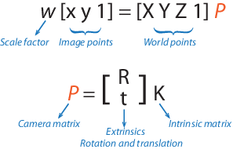
Camera Calibration
Estimates the parameters of the imaging system (intrinsic parameters) and the relative poses of the coordinate frame of the sensor w.r.t a coordinate frame of the scene
Measures locations and sizes of objects in units used for their physical description
Determines the actual location of the camera in the scene and to correct for any lens distortion
Notes:
The first important step for any computer vision application is camera calib. Say first line

Slide 8
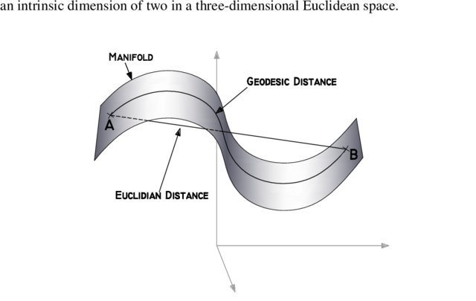
Feature Extraction to classify clusters of pixels:
Classifies key body extrema parts such as head, (R/L) hands and (R/L) feet.
Estimates human poses or analyses gait movements
Reduces training time and memory usage.
Robust against varying poses and body deformations: Geodesic distance
Notes:
instead of using whole depth data, a set of unique features can be extracted and used to classify key body extrema parts such as head, (R/L) hands and (R/L) feet. It is possible to estimate human poses or track gait movements by generating skeleton model with just those detected key parts. Such an approach would help in reducing training time and memory usage.
The features like geodesic distance are robust against varying poses as distances are measured over body surface
“our proposed algorithm detects key parts at cluster-wise segmentation through analysis of geodesics meshes computed from a smaller dataset (less than 18k).
Measured between any two points on the surface.
Surface can be approximated by mesh graph with point cloud as vertices.
Geodesic distance is approximately computed as a sum of weighted edges between two vertices pf the graph.
Used to extract feature points thereby localizing the specific key body parts”.

Slide 9
System Overview

Slide 10
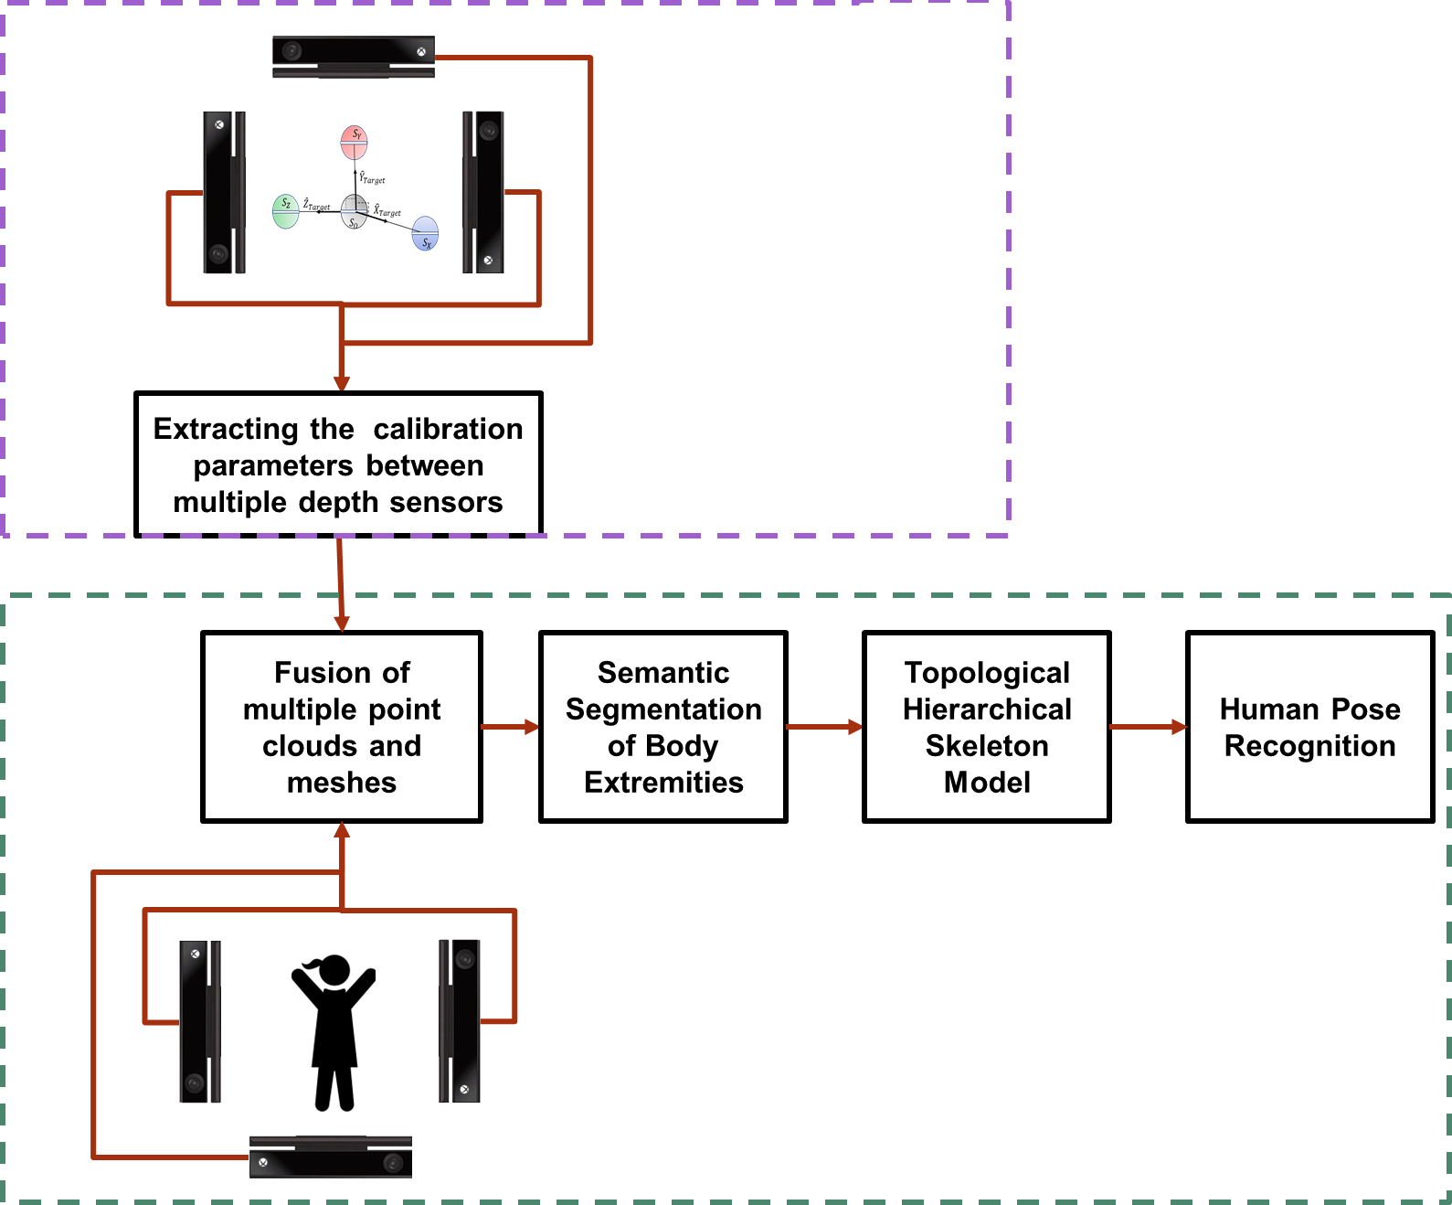
Notes:
The proposed framework is divided into two stages: 1st stage calibration
To calibrate the relative positions of multiple depth sensors for fusion of information.
2nd stage
To generate and label key body extremity clusters through geodesic mapping.
To recognize poses through the hierarchical skeleton tree graph from labelled body extremity clusters

Slide 11
Experimental Setup

Slide 12
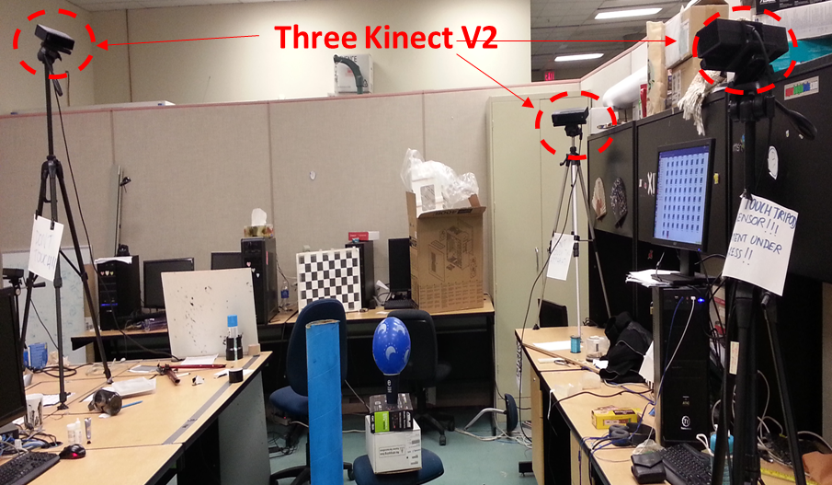
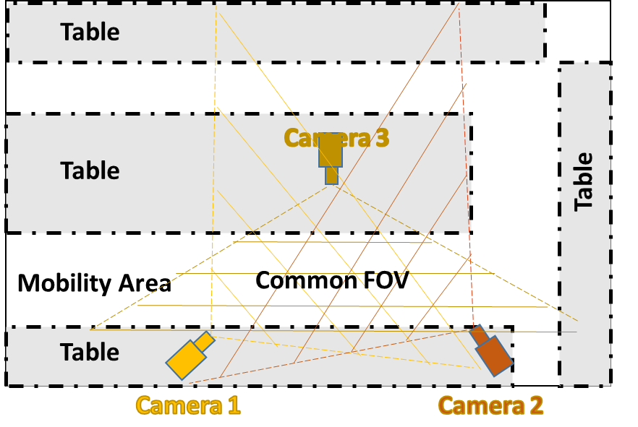
EXTERNAL HARDWARE
3 MS Kinects RGB, IR, depth
DRIVER LIBRARY
“libfreenect2” driver.
CPU
Intel 4 GHz Core i7-4790k with 16GB RAM
Notes:
The experimental setup is composed of 3 main structures: …….
Kinects sensor places in trainagle to increae coverage for experimental observations
Talk about mobility area
Use the pointer
The data is collected from the network of 3 Kinect sensors in order to validate proposed framework

Slide 13
Calibration of Multiple Depth Sensors using Spheres with Retro-Reflective Patterns

Slide 14
Calibration of Multiple Depth Sensors
Establishes a relationship between the data collected from multiple viewpoints
Enables fusion of data from multiple sources
Usage of Spheres ->the projections of sphere remain invariant on different view planes
Notes:
The 1st stage of propose framework calibrates multiple depth sensors. This calibration …..
Use of spheres for claibration

Slide 15
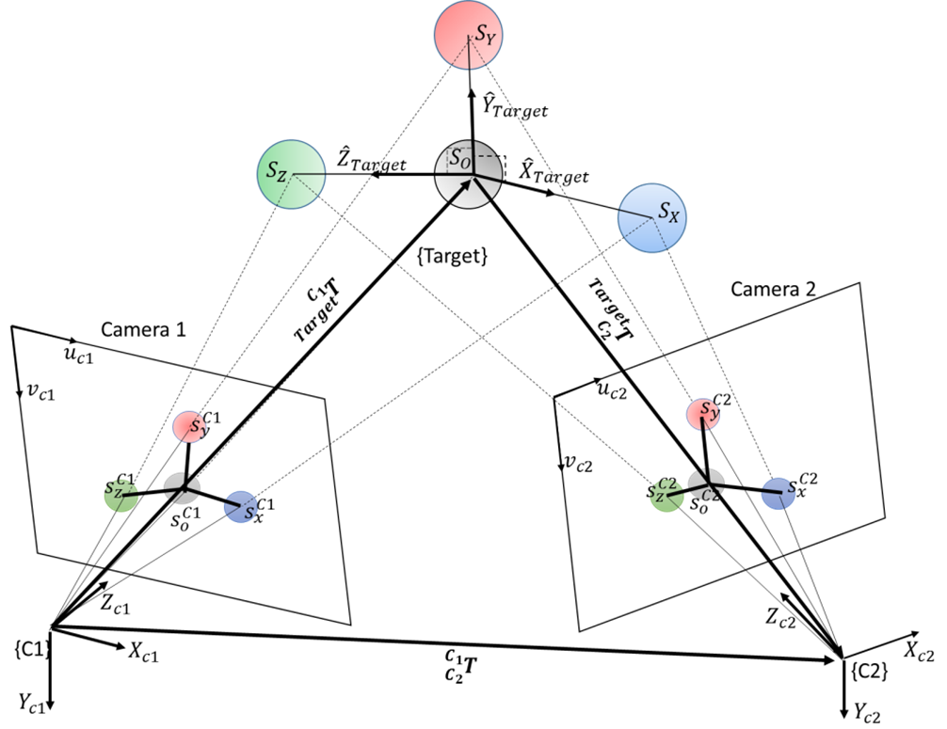

Calibration Target Model
$${}_{C_{2}}^{C_{1}}T={}_{Target}^{C_{1}}{T }{}_{C_{2}}^{Target}T$$
Notes:
the schematic of the proposed calibration setup representing a 3D Cartesian coordinate system (e.g. calibration target coordinate frame {Target}). Once the centres of the spheres in the model are estimated with respect to each of the camera's coordinate frame, the direction of unit orthogonal vectors ${\hat{X}}_{Target}, {\hat{Y}}_{Target}, {\hat{Z}}_{Target}$ can be obtained with respect to each camera frame within bounded error limits. The spheres in calibration set-up are physically configured in such a way that its axes are mutually perpendicular.
the transformation matrices between the calibration target tool frame and each camera frame can then be used to find homogeneous transformation matrix between cameras

Slide 16
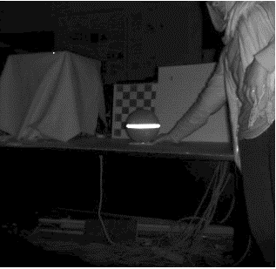

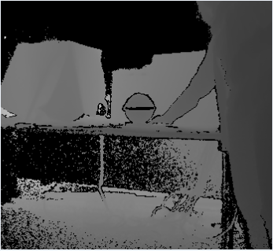


Localization of Retro-Reflective Stripped Sphere in a Sensor’s Frame
2D IR-based localization of spherical centre
Segmentation through thresholding
3D projection of the centre point
With known nominal radius of sphere, the central point between ends of the strip can be projected as 3D spherical centre
IR image
Segmented RR strip
Binary mask creation
Segmentation through masking
Depth image
Circular binary mask
Segmented Depth image
Central estimation of spherical point cloud
3D depth-based localization of spherical centre
3D Point cloud with localized centre
Notes:
Here is The overall process of localization of spherical centre using either IR-based 2D data and depth-based 3D data. a) segmentation of RR strip in IR image through thresholding: mid-point and distance between strip ends act as projected centre and diameter of spherical projection for IR-based process; b) formation of circular binary mask from RR strip; c) segmentation of spherical projection in the depth image through binary mask and d) central position estimation of segmented 3D point cloud.

Slide 17
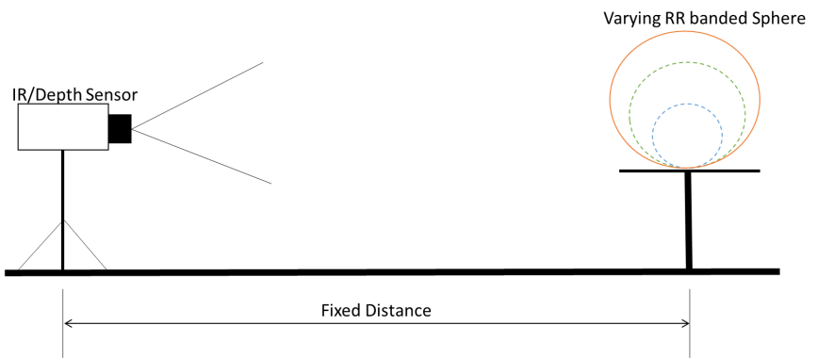
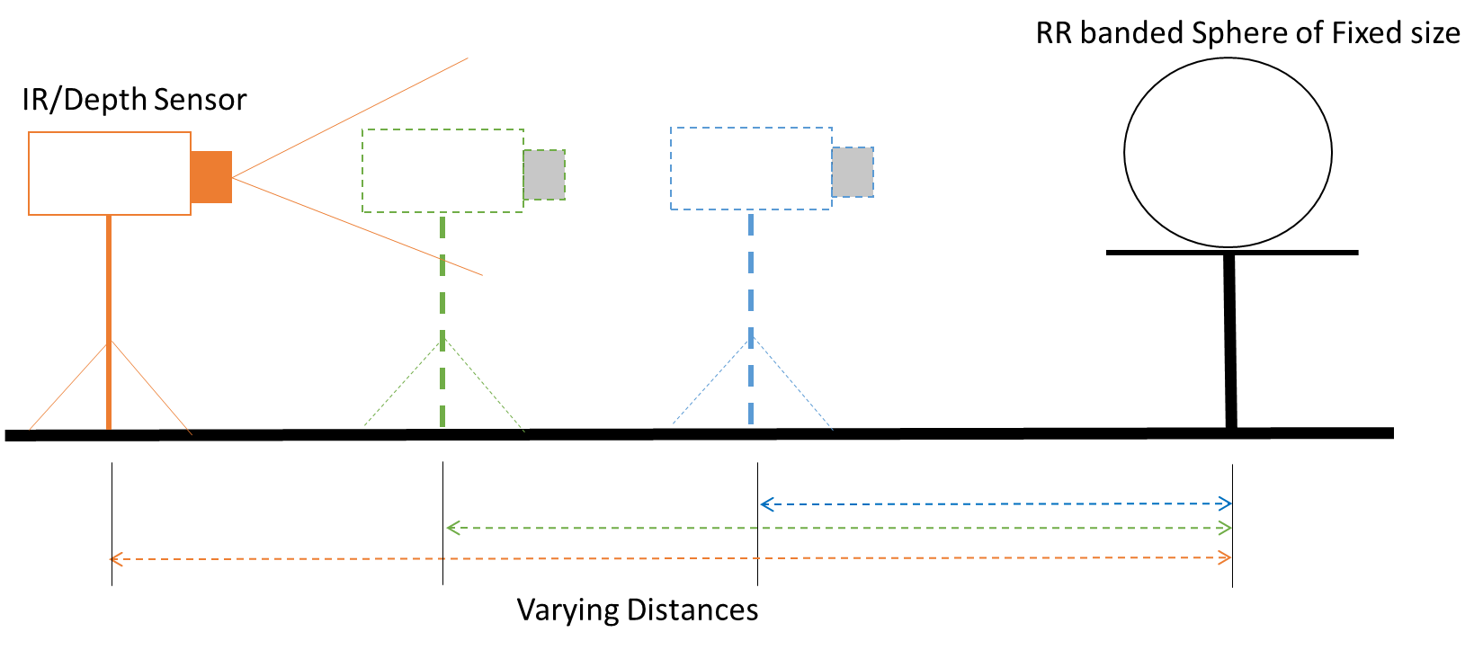
Experimental Study of Localization of Spheres
Notes:
general guideline for the calibration setup of depth sensors using spheres with RR band

Slide 18
Estimation Error In The Centre Position Of Each Sphere Of Varying Diameters Against Varying True Distances
2D IR-based localization
3D depth-based localization
Notes:
As you can see on the right side that the 2nd localization method has performed beterr than that 1st method. This is due to Depth data offer more accurate 3D info than provided by 2D based IR image
[Aslo, a point to be noted than As the distance between sensor and sphere increases, the spherical position estimation error tends to increase. However, if the size of the sphere is larger, then the spherical position estimation error can be maintained at a low level.]
The error in localization of sphere tends to decrease as the size of spheres increases due to the availability of more 3D surface points of sphere captured by a sensor. Hence, it is important to ensure the use of bigger RR striped spheres of calibration target model for better localization. At larger distances

Slide 19
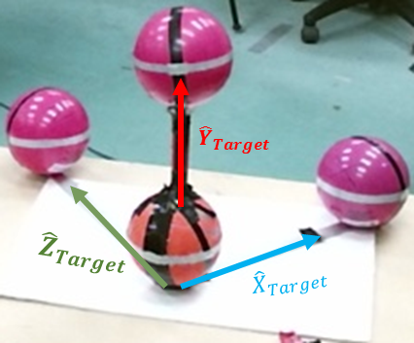
Calibration Target
All RR-striped spheres of the model appear in the FoV of all multiple cameras.
Centers of three spheres are connected by orthogonal axes with one sphere as the origin.
The unit vectors follows the RH rule convention.
Diameter for all spheres is 0.155 m
Notes:
This is the picture of calibration tool

Slide 20
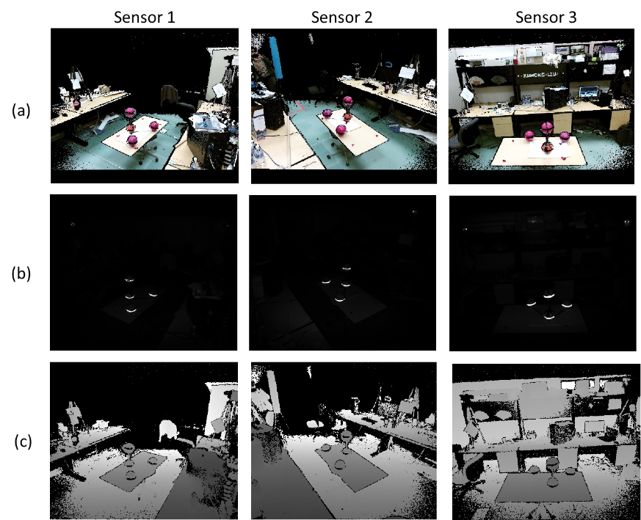
Notes:
And its data capture from multiple depth sensors

Slide 21
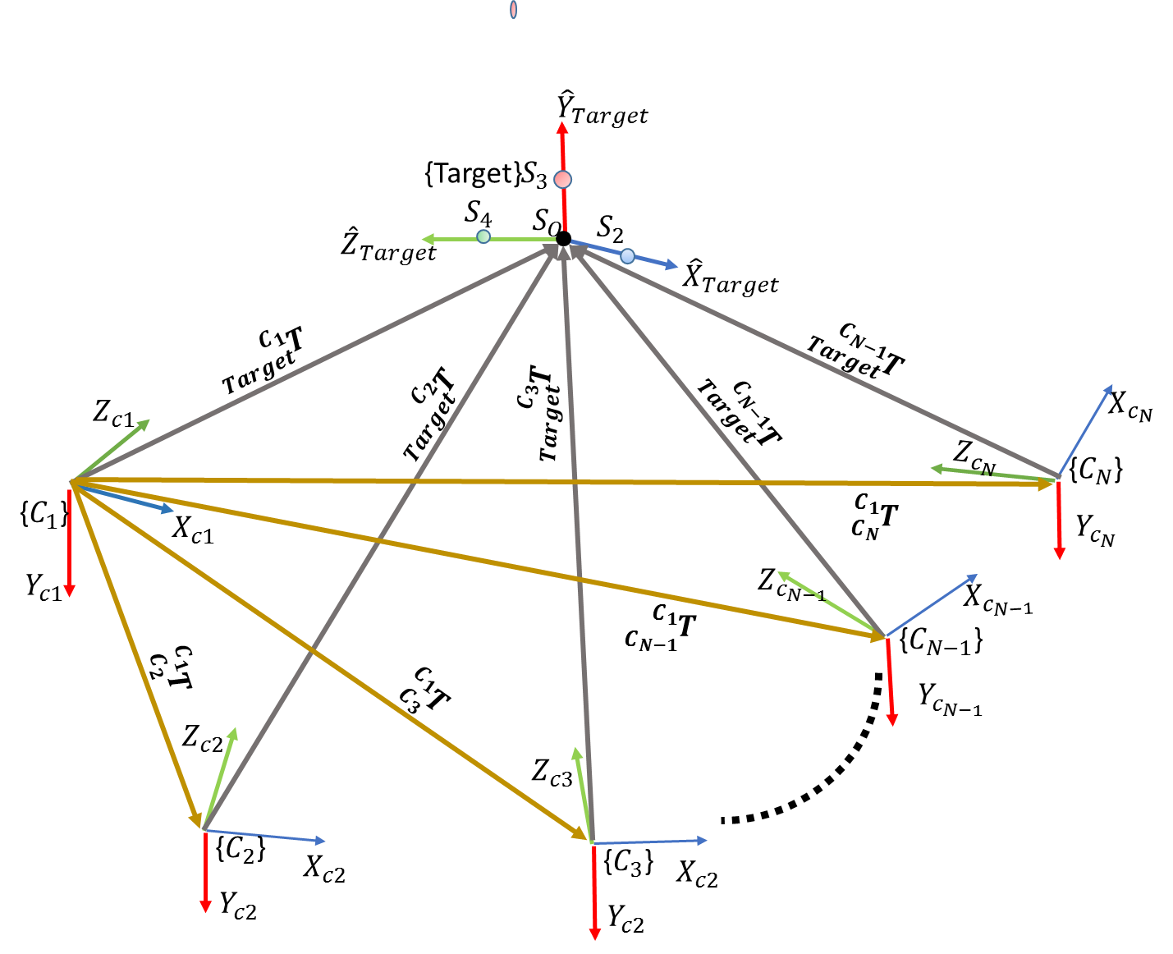

Slide 22
Flowchart of Calibration Process
Notes:
Once we have localized the four spheres of calibration tool, we choose the best 4 or 5 valid framesets. From these frameset, we further compute to find the optimized transformation matrices between target tool and sensors. These matrices gives us extrinsic calib parameters between sensors

Slide 23
Notes:
Here the final fused point cloud of calibration target tool

Slide 24
Comparison against other state-of-art techniques
Notes:
For comparative purposes, we show our proposed calibration method with the existing calibration techniques.

Slide 25
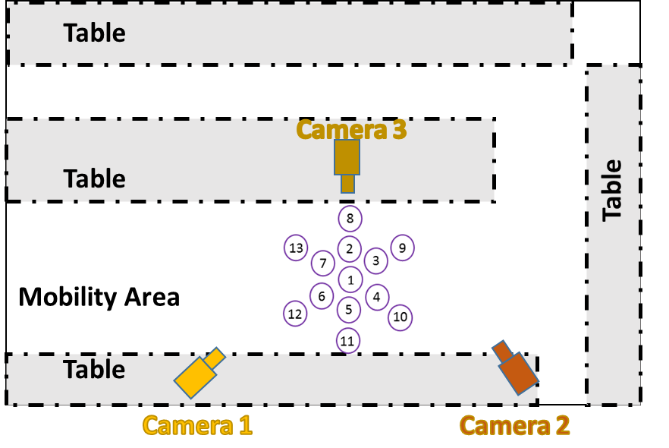
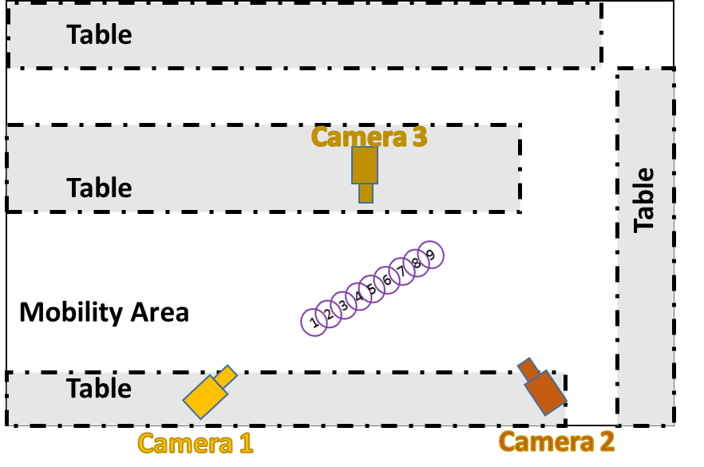
Testing Metrics | Experimental configuration | Path type of ECO* | No. of positions of ECO* | Evaluating Parameters
Shape reconstruction | State-of-art techniques: chessboard, planar, ICP and proposed | 2 concentric hexagons | 13 | Radius of ECO: 0.095m
Spatial consistency | State-of-art techniques: chessboard, planar, ICP and proposed | Straight line | 9 | Transversal interval distance: 0.15m
* Evaluation Cylindrical Object
Notes:
We tested existing methods and our proposed method on metrics : shape reconstruction and spatial consistency. And here are the results

Slide 26
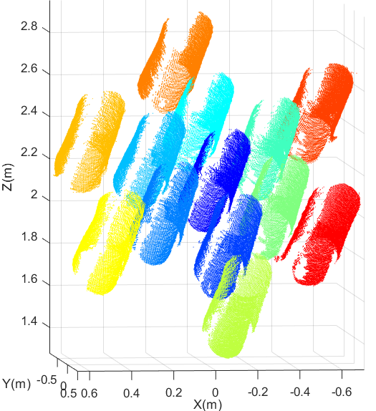
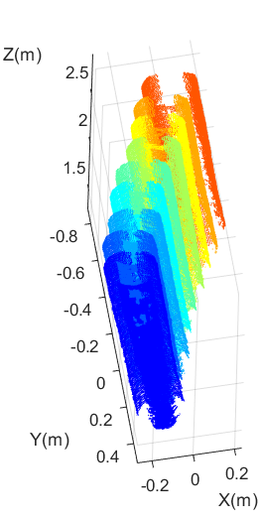
Shape Reconstruction
Spatial Consistency
Notes:
Here are Qualitative reuslts

Slide 27
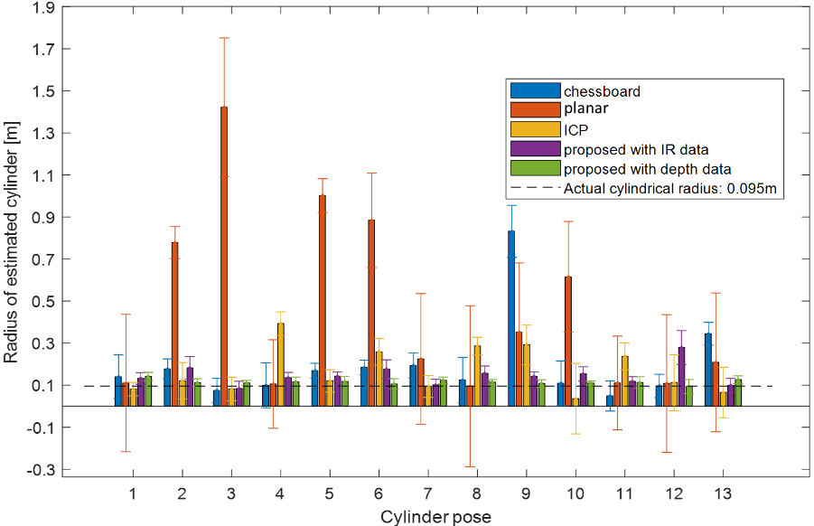
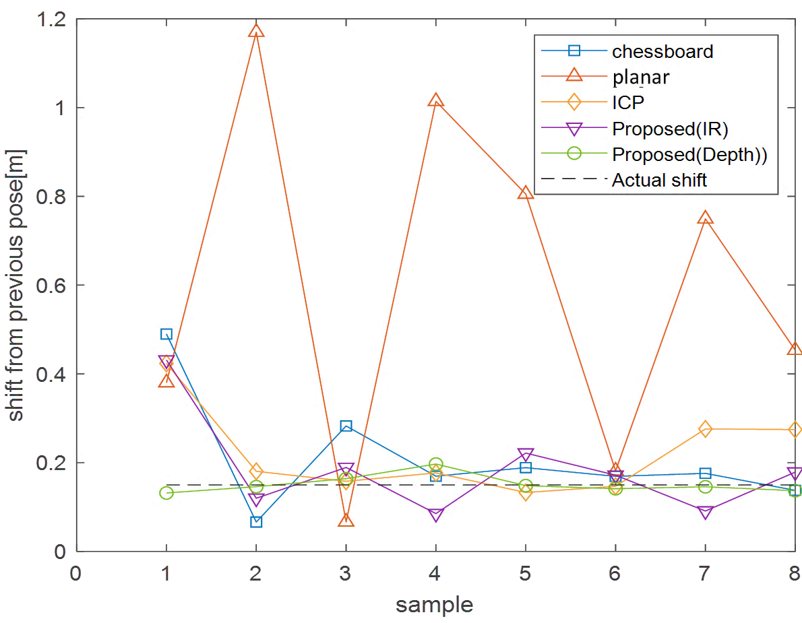
Shape Reconstruction
Spatial Consistency

Slide 28
Overall Evaluation Results
Calibration Techniques | Overall Evaluation Results
 | Shape Reconstruction: Error in estimating the radius of ECO at 90% (m) | Spatial Consistency: Mean difference between estimated and ground truth translational shift of ECO along a straight line (m)
Chessboard | 0.30 | 0.084
Planar | 0.80 | 0.473
ICP | 0.19 | 0.074
Proposed (IR) | 0.06 | 0.074
Proposed (Depth) | 0.02 | 0.013
The calibration target model as world frame coordinate system
The computed extrinsic parameters can be used for the measurement of 3D human posture recognition while eliminating the need for RGB data and dependence on illumination.
More Details
Notes:
Here are the Quantitative results. In terms of both shape reconstruction and spatial consistency, the proposed approach produces error below 2 cm at 90% of the time which better compared to other existing approaches
this calibration approach will be used to combine point clouds of data from multiple sensors
thereby forming point cloud of a human subject for key body extremity detection and posture recognition.

